Slide 1

Teach Me
COMP8117 Advanced Software Engineering Project
Group 30
Aayushee Dave(110023928)
Manan Parmar (110022360)
Rahul Pandya(110024678)
Richa Gupta(110013520)
Notes:
Hi guys, very good morning, as a part of Advanced Software Engineering Project.
We have developed a web application called TeachMe, to help students learn better by giving Quizes.

Slide 2
Outline
Objectives
How Teach Me Works?
Team Management
Tools and Techniques
System Tests
User Stories
Demo
Verification and Validation
Conclusion and Future work
References
Credits
Notes:
In this presentation, we are going to cover these topics.
We will start with, the goals and objectives of our project
Followed by How it works?
Then we will show you which team management tools we have used in our project
Then we will go through the tools, techniques and architecture used in our project
Followed by user stories and system tests
Then we will show you the screenshots of different modules of our application
Next we will see the verification and validation of the application.
Lastly we will go through conclusion and future changes that can be done in our application.

Slide 3
Goals / objectives
To create online learning website, where students can give tests and get personalized reports.
The application can understand the student's caliber and ask questions accordingly.
It also gives personalized recommendations in form of reports.
Is not meant to replace the conventional exam method for ranking the students, instead to keep it alongside with the conventional exam to help recognize students their areas of improvement.
Notes:
There are a lot of online learning websites. You might be wondering what makes Teach Me different!
Teach Me unlike other applications has the ability to understand the student’s skill and ask questions accordingly.
24-7 access for anyone, anywhere.
Tutor can provide Cheat Sheets(hints) for the test to help the students solve the questions.
Students can get personalized reports giving suggestions about the strengths and weaknesses of a student after every test and their
Areas of improvement.

Slide 4
How Teach Me Works?
Tutor uploads a questionnaire in form of an excel file.
Questions are categorised based on their difficulty.
Students appear for the test.
Question picked at random based on all the previous responses and the difficulty level.
View test reports.
Notes:
There are two types of User: Tutor and Student.
Tutor will upload Test with all the Questions, Options, Correct answers along with their difficulty in the excel file.
Here questions are categorised as Easy, Medium and Hard based on their difficulty level.
Students will be able to see the tests under the subject section once it is uploaded by the Tutor.
The questions in the test are random; The first question will always be picked randomly from the test, the second question will be selected
based on the response of the previous question and the difficulty of randomly picked new question.
i.e.
1. If a user attempted an easy question with a correct response, the next question will be a random question with difficulty level medium or hard.
2. If a user attempted a medium question with an incorrect response, the next question will be an easy one.
3. If a user attempted a hard question with a correct response, the next question will hard as it is max difficulty.
Since each response is recorded Student/Tutor will be able to see their given responses to a particular test in form of Report.

Slide 5
Team Management
Team communication and meetings - Zoom meeting
Repository - GitHub
UI Repository
Back-end Repository
Project management tool - Redmine
Important documentation
Project Development Cycle - Agile Methodology
Notes:
Team management is essential to have smooth ongoing process in order deliver a quality system within estimated deadline.
So, for regular team meetings(Daily Stand ups, Project planning, Backlog refining, Retrospection) and discussions, we communicated through Zoom Meeting.
For repository management, we have used GitHub to maintain Front-end and Back-end separately.
We have used Redmine for maintaining the backlog(Features, user stories, bugs).
In order to follow an efficient development cycle that can help us in dealing with unexpected changes, we've followed agile development model.

Slide 6
Tools and Techniques
Backend Development:
Technique: We are using Java Spring Boot project in the backend. In that we are following Spring MVC framework.
Tools: IntelliJ IDEA as our IDE for development.
Architecture: Project Architecture
Frontend Development:
Technique: For frontend we are using Angular 9 web framework.
Tools: Visual Studio Code as IDE for development.
Database:
Technique: MySQL is used for database.
Tools: MySQL Workbench is used for database management.
Architecture: DB Architecture
Notes:
For the Backend Development we have used Java Spring Boot and we have implemented the project following the Spring MVC framework. Tools used for the development include IntelliJ IDEA and Eclipse.
For the Frontend Development we have used Angular 9 web framework and tools include Visual studio code.
We have used MySQL workbench for the database management.

Slide 7
System Test – Usability
Manual - UI Testing
Manual - API Testing
Notes:
Testing is equally important as the development of the software.
Our software has been tested continuously so that its quality is maintained.
TeachMe application has undergone two phases of Testing.
The Pie charts shows an overview about the Test results during the First and Second Iteration of UI and API testing respectively.

Slide 8
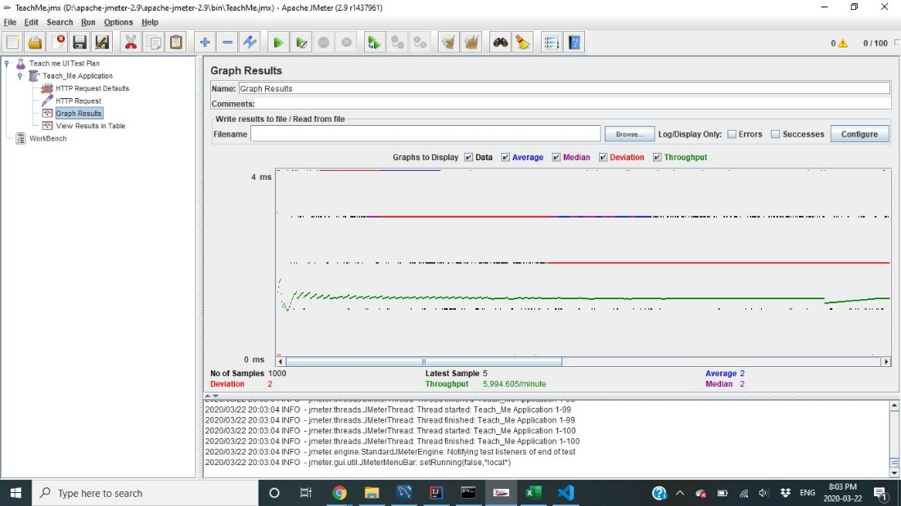
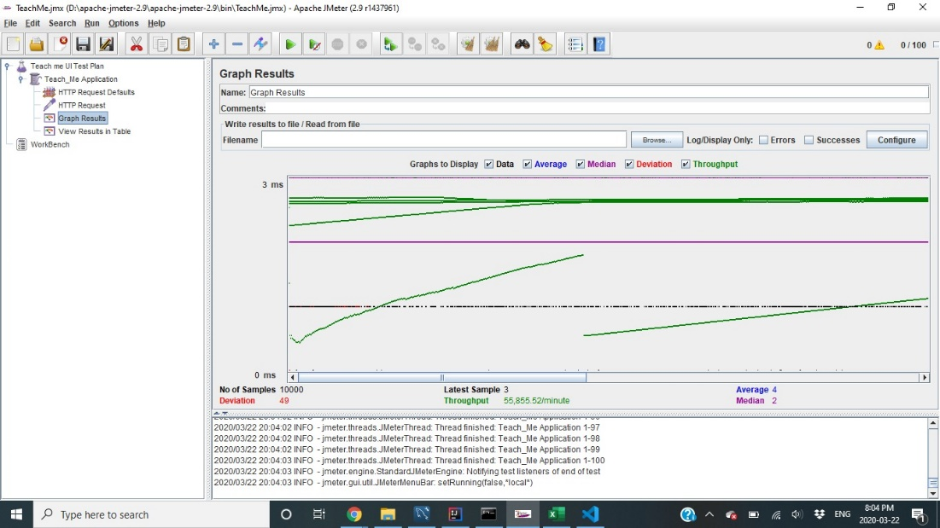
System Test – Performance & Volume
Both using JMeter Tool
1,000 concurrent Users
10,000 concurrent Users
Max file size this app can handle is 10485760 bytes, around 10 MB
Notes:
We have tested the TeachMe applications performance by its capacity to handle number of concurrent users.
We have used JMeter to test the performance of this application.
The results show that TeachMe has the ability to handle 10,000 concurrent users.
throughput of the application is not impacted by number of concurrent users using the application.
For low number of users, the application is fairly stable, if the number of user increases, the deviation can be seen.
Volume Testing: we also performed Volume testing using this tool, and after carrying out multiple rounds of experiment with multiple files of different sizes. And conclude that, the max file size that can be handled by our Application is around 10MB.

Slide 9
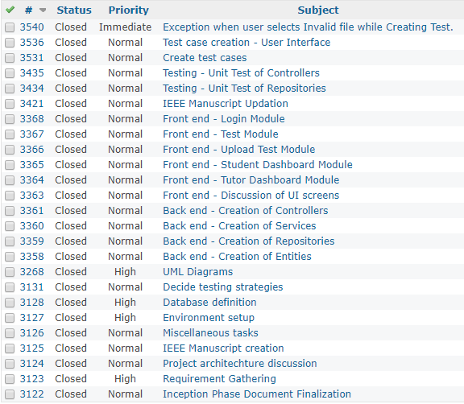
User stories
User stories completed in Phase I and II
Notes:
These are the user stories which are completed in the two phases. User stories consists of tasks related to backend, frontend and testing.

Slide 10
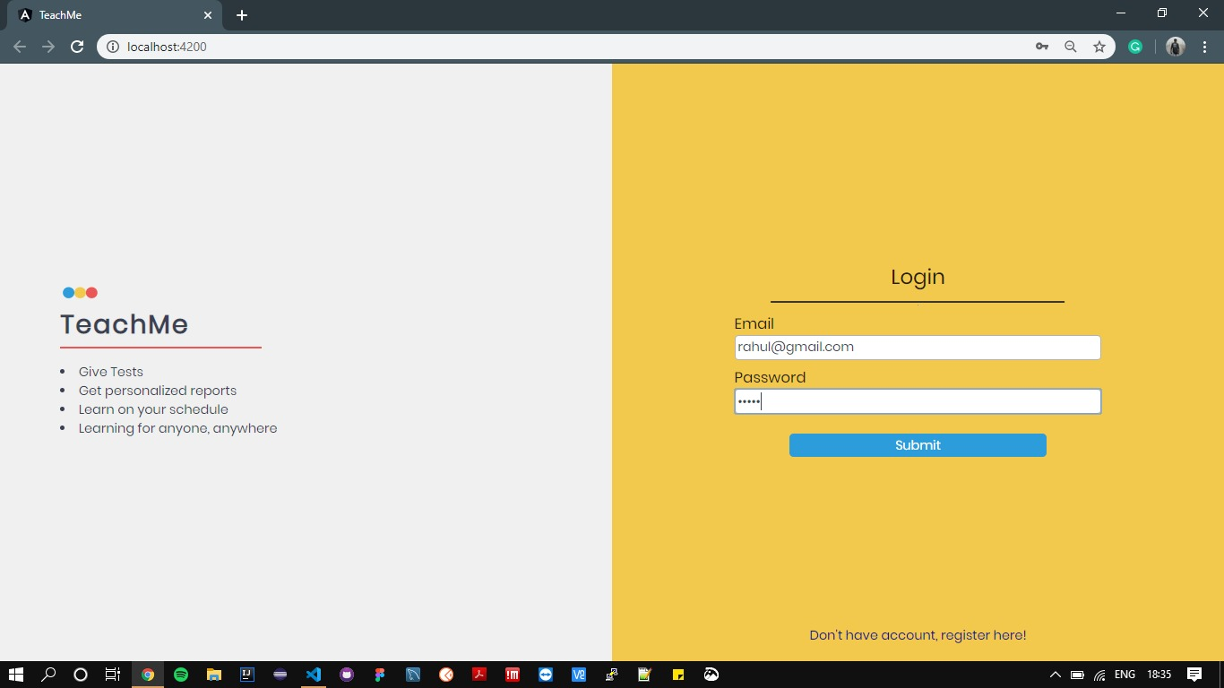
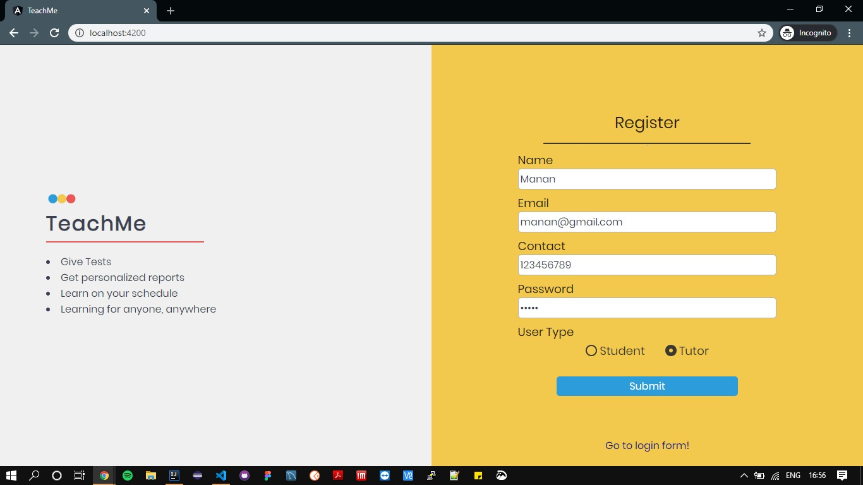
Demo - Login/Registration
Login Page
Registration Page
Notes:
A new user will have to register in order to access the system.
The user type will be decided at this moment. If you select tutor you’ll be able to create subject and upload tests and view student reports.
If you select student then you’ll be able to take tests and view your reports.
After registering the user will be directed to their respective User Dashboard.
Once registered the user can Login to the system, without selecting the user type.

Slide 11
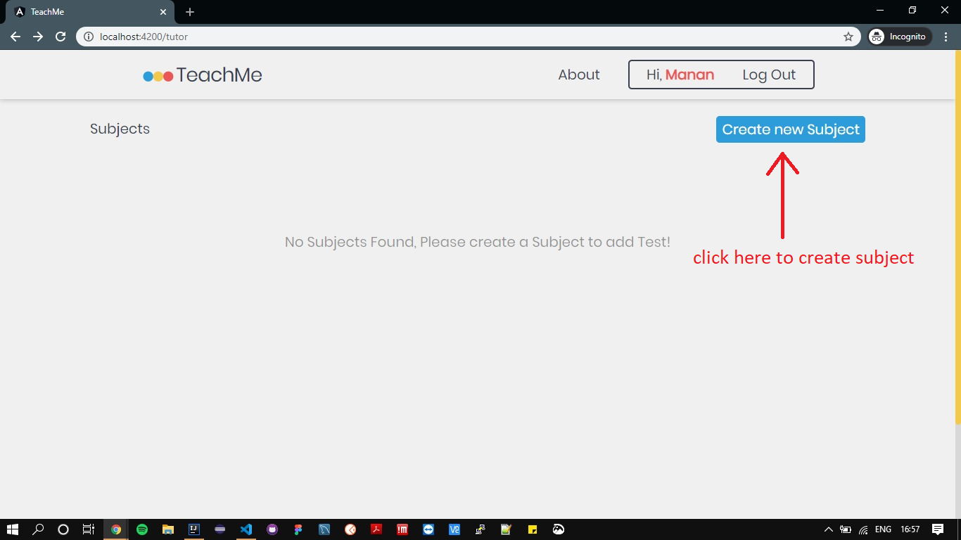
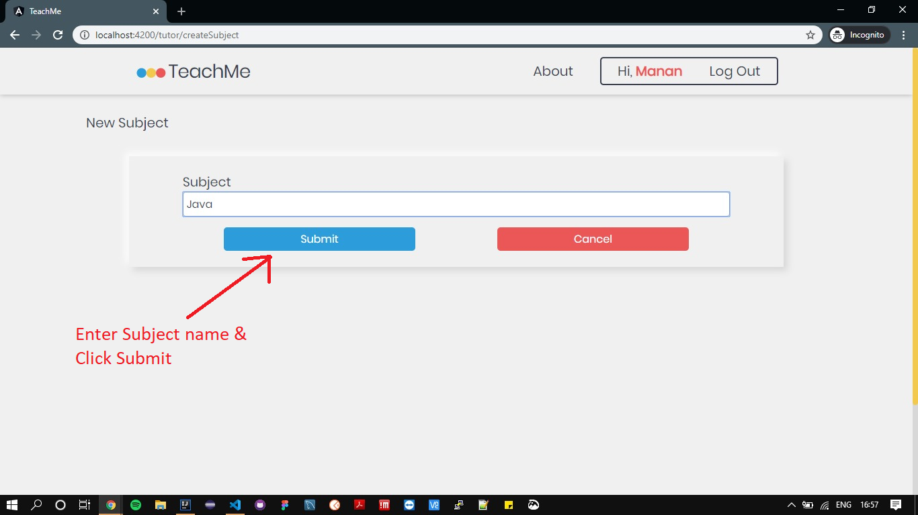
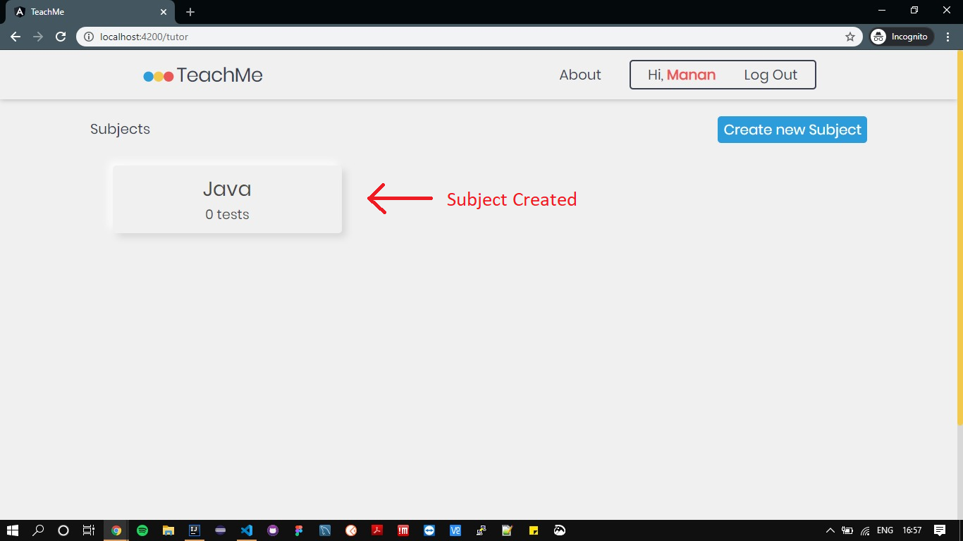
Tutor Demo – Creation of Subject
Notes:
Once the Tutor is registered to the system, the user will land on the dashboard page.
Tutor will be able to Create New Subject.
The tutor will be asked to enter the subject name and clicking on Submit button will create the subject.
Once the subject is created the Tutor can view the subject on their Dashboard.
Click on this Subject card to view the tests

Slide 12
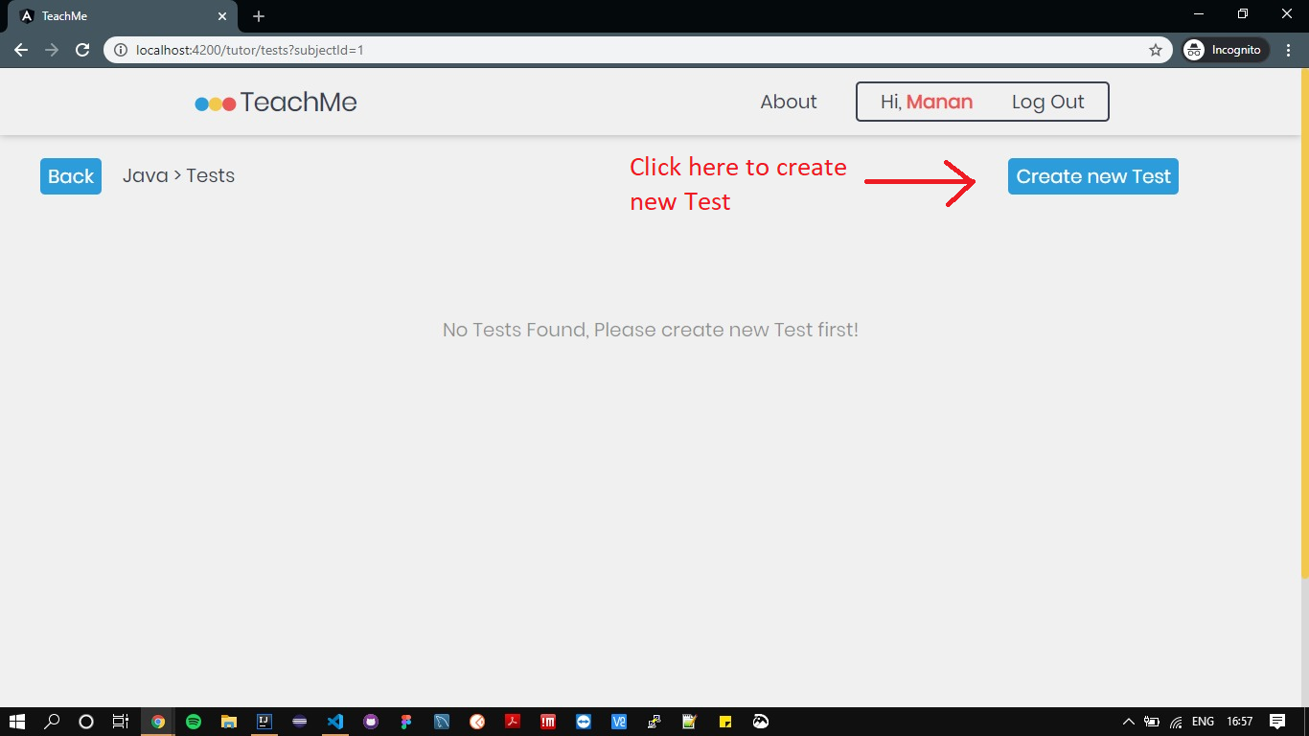
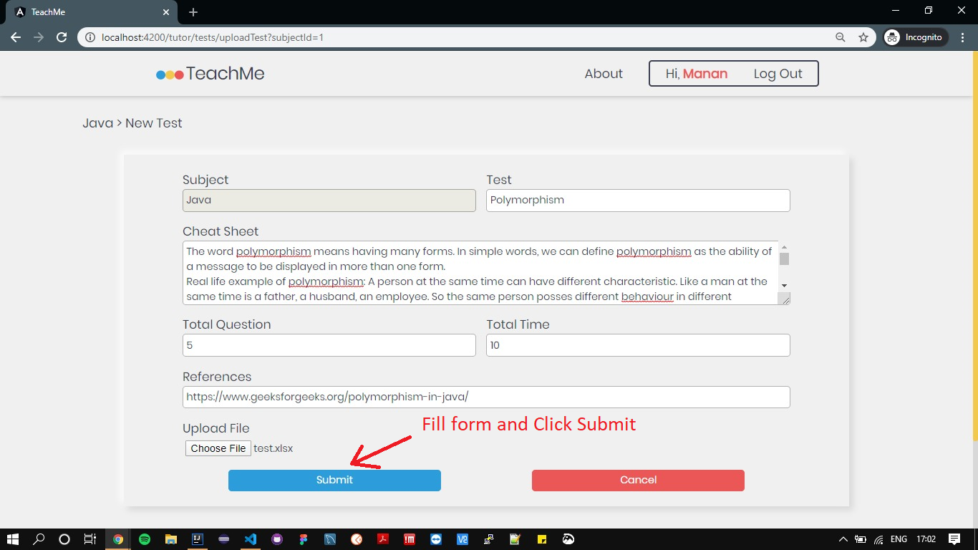
Tutor Demo – Creation of Test
Notes:
After creating the subject the Tutor will be able to create Tests for the subject.
Tutor will have to upload an excel file consisting of all the Questions, Responses and their difficulty level from this page.
In the upload test form Tutor will be asked to input the Test name, Cheat Sheet, total questions, total time for the test and References.
The test will be created once the Tutor hits the Submit button and will appear under the Subject section

Slide 13
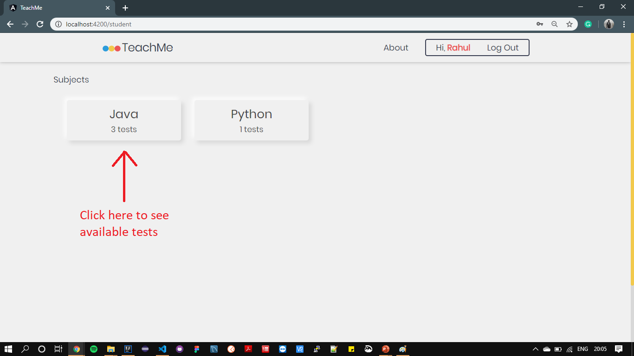
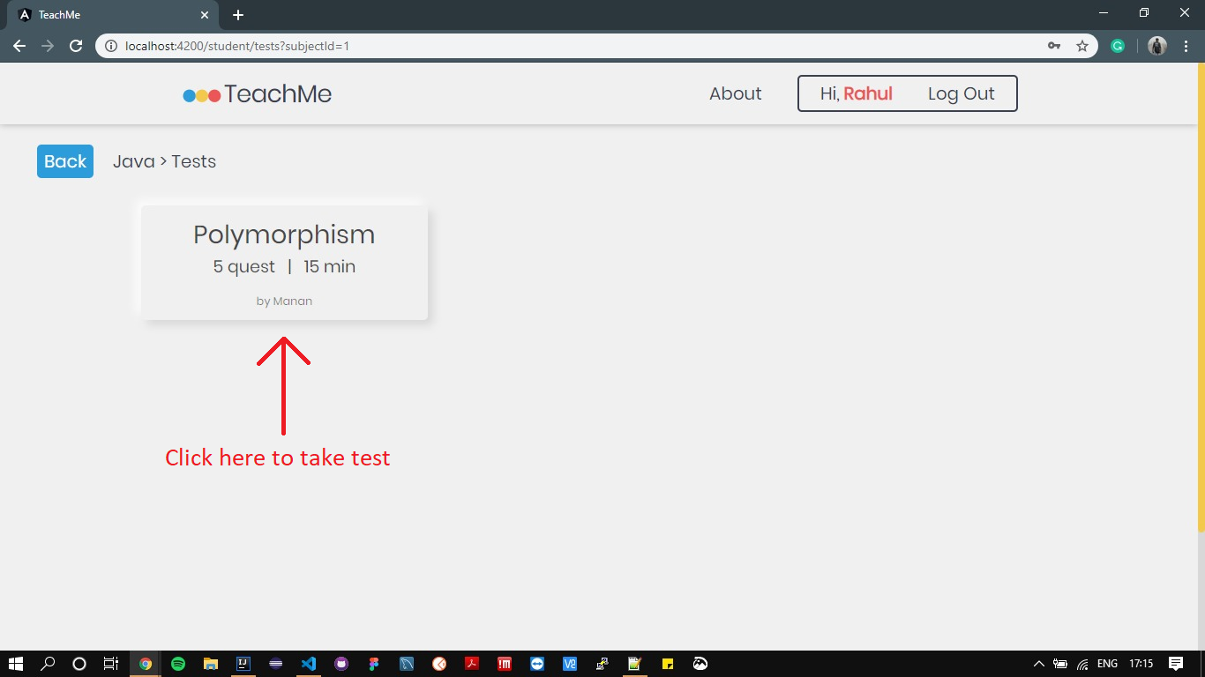
Student Demo – Browsing to Test
Notes:
In order to give tests the student needs to get registered to the system.
Once registered the student will be able to see different subjects and total tests in the subject.
The student can select a topic under the subject section and start taking the test.

Slide 14
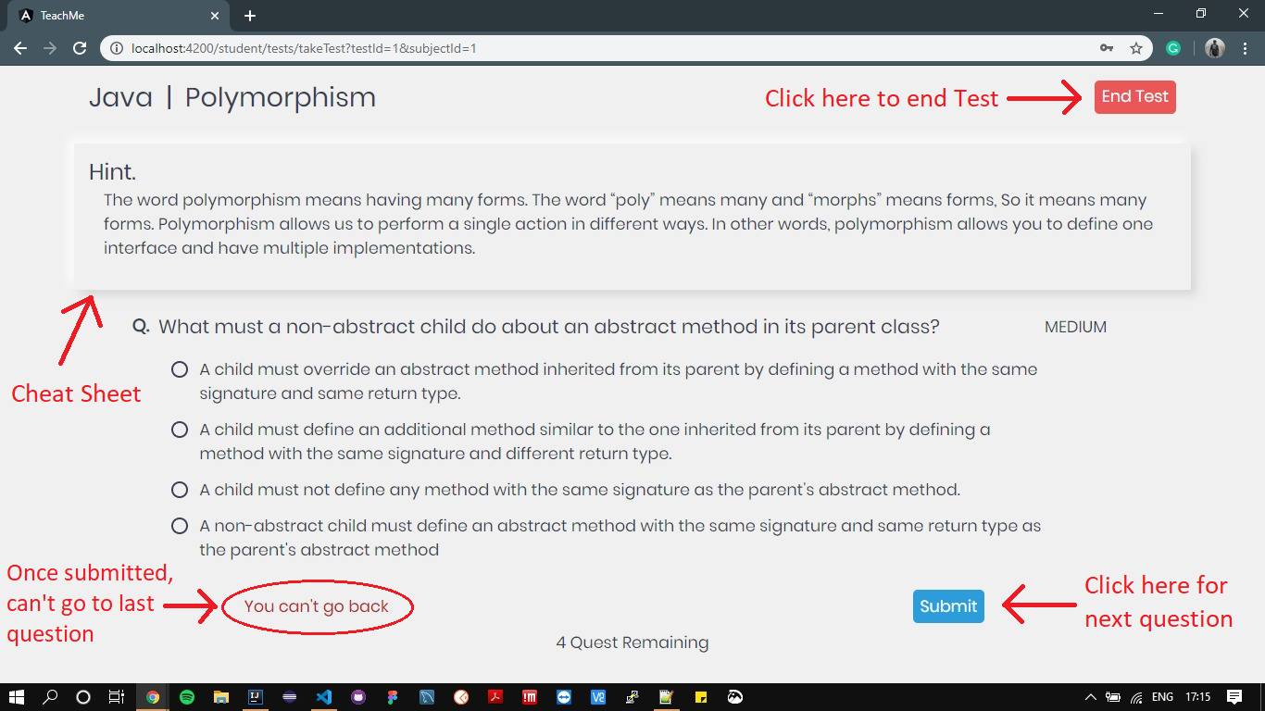
Student Demo - Test
Notes:
Once the Student clicks on the Test, the test will begin.
On the test page there will be a cheat sheet which will help the student to answer the questions.
One question along with difficulty and the options will appear at a time to the student.
On selecting a option and clicking submit, next question will appear until the last question is reached.
Once submitted, student is not allowed to go to previous question.
On clicking submit on the last question the test will end.
Student can end the test anytime by clicking the End Test button.

Slide 15
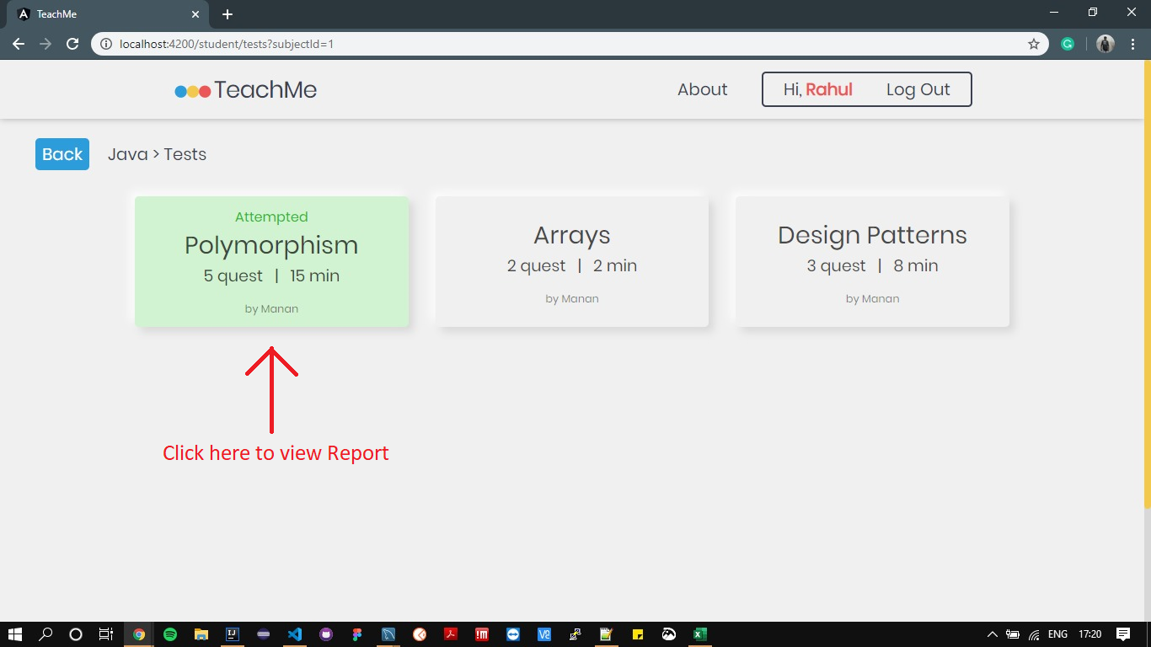
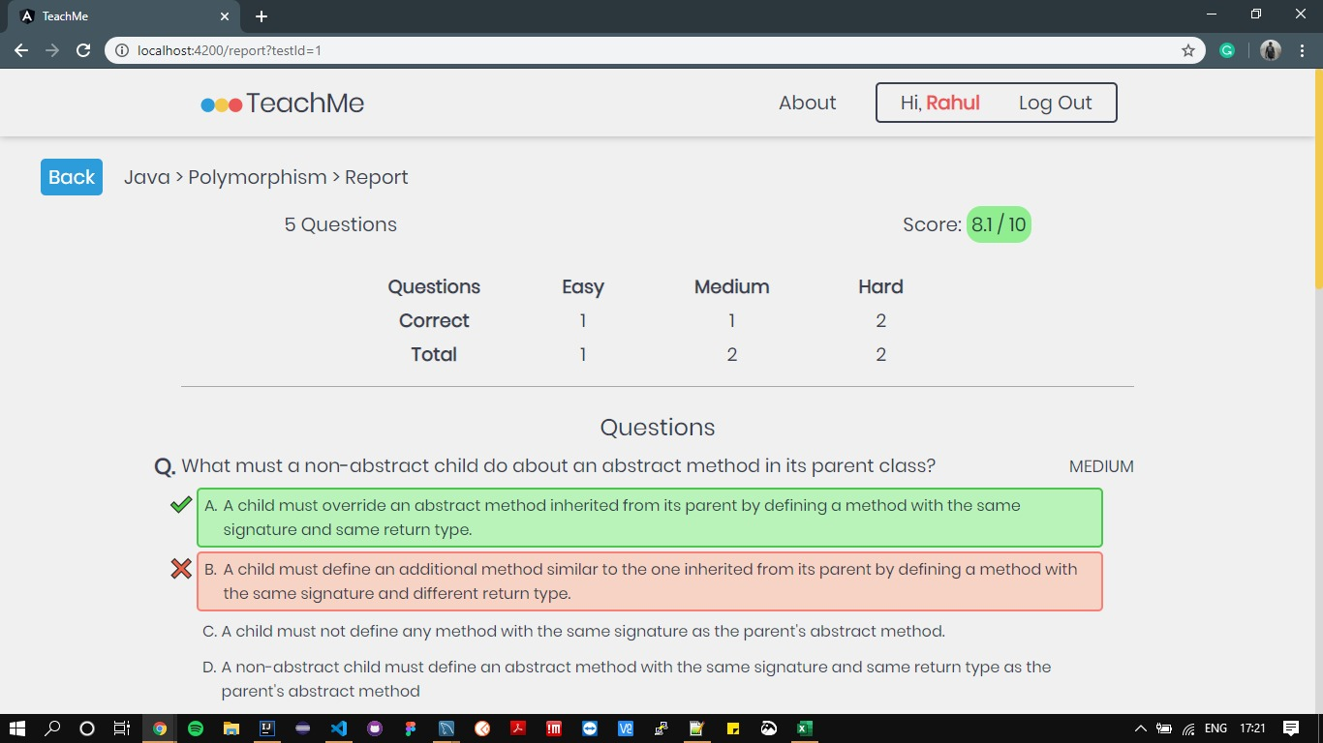
Student Demo - Report
Notes:
Once the test is submitted, it is highlighted as attempted on the tests’ list page
After test, the student can view the test report by clicking on the highlighted test.
This report contains stats about the test like total score, number of easy, medium and hard questions long with the response and correct answer.

Slide 16
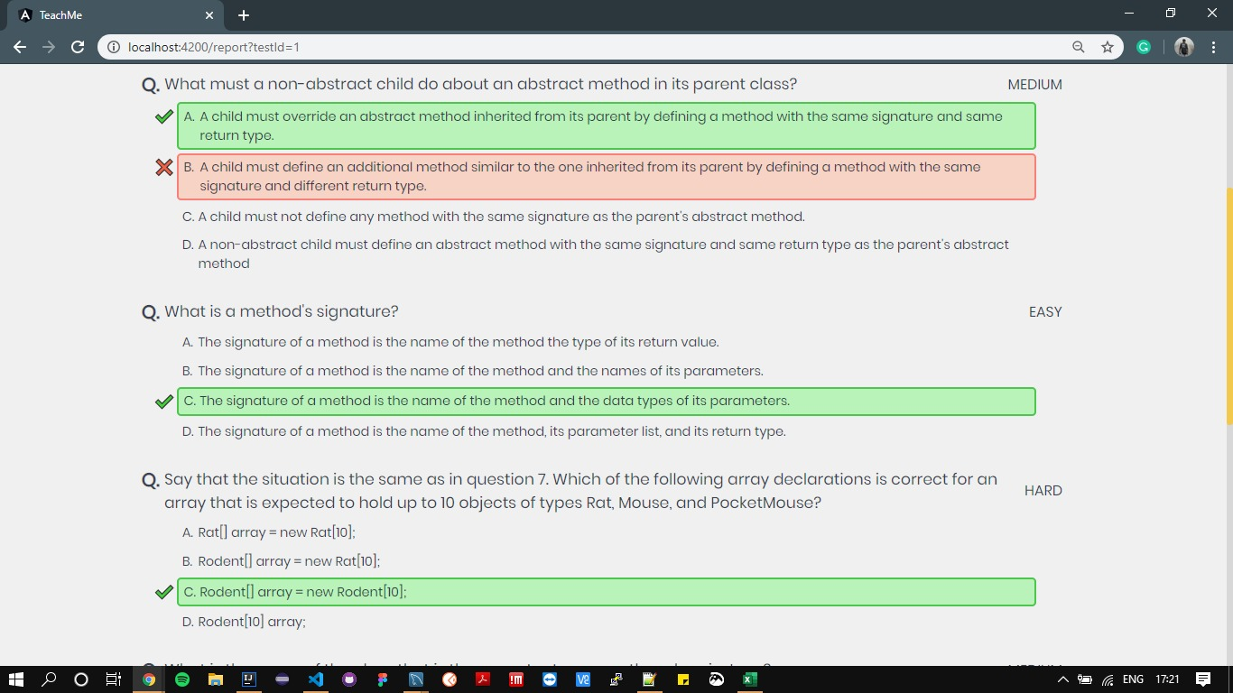
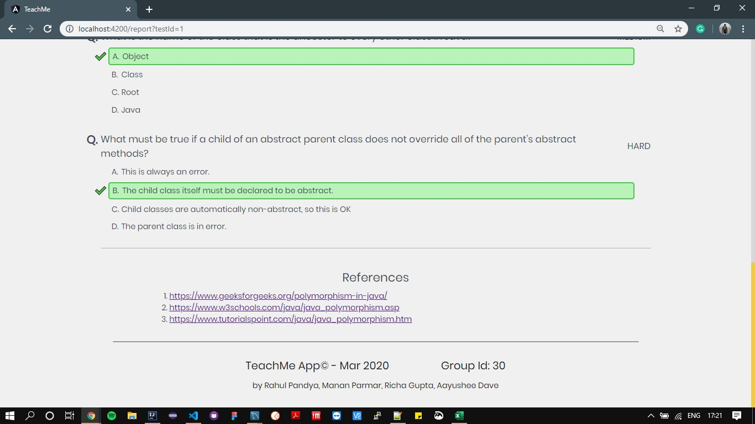
Student Demo - Report
Notes:
At the bottom of the page, the references will be provided in order to improve over this topic.

Slide 17
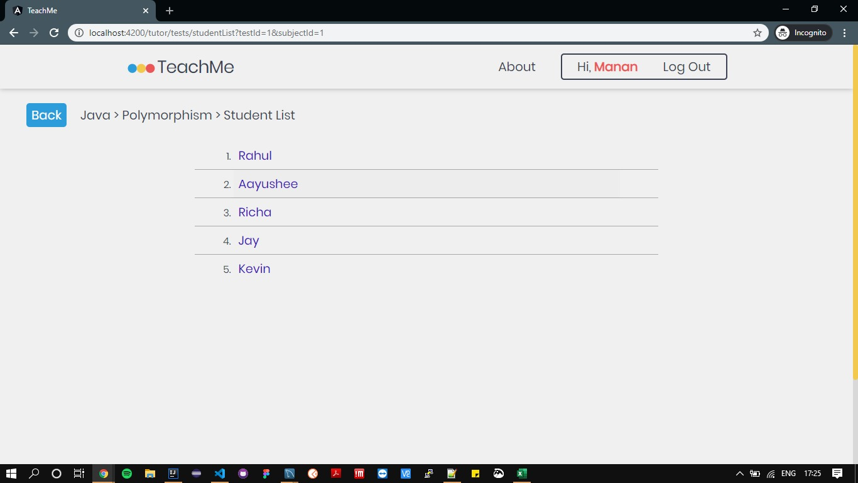
Tutor Demo – Student Report
Notes:
The tutor can also view how many and which students have attempted the test.
upon clicking the student’s name, the tutor will be redirected to his/her reports page of that particular test.

Slide 18
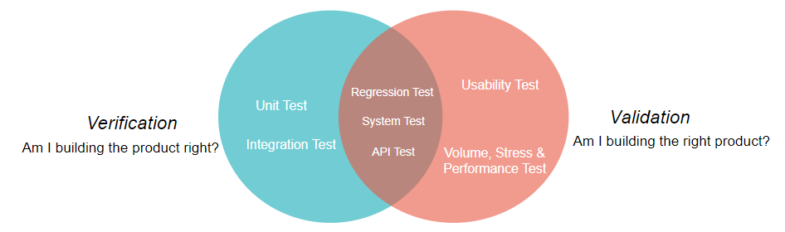
Verification, Validation and Risks
Concerned Risks:
Security
Notes:
Verification and validation:
We have followed the verification process for our application to check that it meets all the specified requirements at a particular stage of its development. For this purpose, we carried out activities such as unit testing, integration testing of the system whenever a new feature was implemented.
Furthermore, regression test, system tests and API tests were done to confirm that the system responds as expected.
Finally, usability testing was done followed by volume, stress and performance testing to validate the application.
After verification and validation of our application, we can conclude that it works as expected and meets the objectives for which it is designed.
Concerned Risks:
The most concerning risk that we identified is security. Due to time constraints, we were unable to add spring security while login so that the confidentiality of any user is not compromised. Also, while attempting the quiz, the security aspect needs to be added.

Slide 19
Conclusion and Future work
Conclusion: From this project we learnt how real world applications are developed following the Software Engineering practices.
Future Work:
Collaborate with Universities and schools
Create more personalized reports that suggests students the topic they need to work on.
Login security
Notes:
We can collaborate with the schools and universities around the city to let the students give online test uploaded by their tutors.
We can improve the reports by providing more personalized reports generated from the student test statistics which will identify the topic that they need to work on.
Also the login security can be improved using spring security.

Slide 20
References
Apache POI: https://www.tutorialspoint.com/apache_poi/apache_poi_overview.htm
Jmeter: https://www.guru99.com/introduction-to-jmeter.html
API Testing: https://www.guru99.com/api-testing.html
Spring Boot Documentation: https://docs.spring.io/spring-boot/docs/current/reference/htmlsingle/
Angular Documentation: https://angular.io/docs
Notes:
Here are a few links that we have referred for the development of this project

Slide 21
Credits
Dr Zaid Kobti, Professor, Director of School of Computer Science at University of Windsor.
Dr Luis Rueda, Professor, School of Computer Science at University of Windsor.
Ryan, Fen and Raj, TAs of Advanced Software Engineering
Notes:
We would like to thank Dr. Kobti and Dr. Rueda for their continuous guidance in the development of this project.
We are also thankful to TAs: Ryan, Fen and Raj.
We would also like to thank all the students and tutors for giving feedback about the features implemented in this application.

Slide 22
Thank You
Contact Information:
Rahul – pandya51@uwindsor.ca
Manan – parmar6@uwindsor.ca
Richa – gupta14h@uwindsor.ca
Aayushee – dave71@uwindsor.ca
Notes:
If you have some questions in mind, here is our e-mail id, feel free to contact.
Thank You and have a wonderful day!

